Slide 1
Analysis of Internet Speeds in the United States
Ali Taheri and Mike Hendrickson

Slide 2
Agenda
The importance of the internet
Discuss the dataset
Methodology for exploratory analysis
Results and Discussion
Conclusion

Slide 3
The importance of the internet
Access to information
Use at home, school, library, etc.
Bandwidth per user per device
Average of 2.9 connected devices per person in 2014
https://www.statista.com/statistics/333861/connected-devices-per-person-in-selected-countries/
Net Neutrality Implications
Will bandwidth even matter?
“scientia potentia est” – knowledge is power

Slide 4
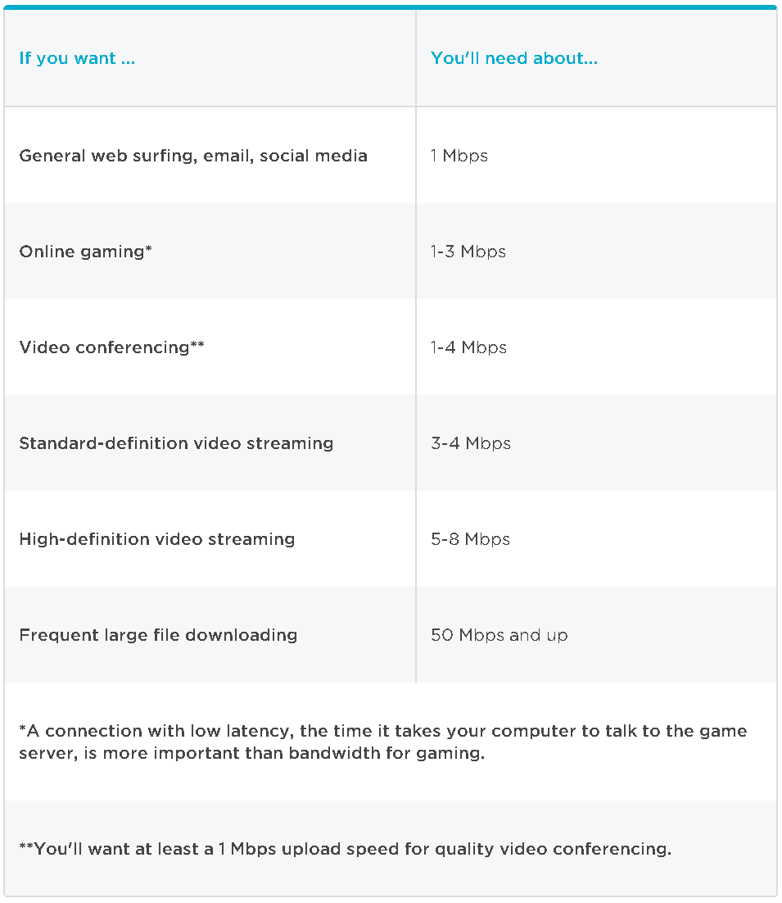
Understanding the Background
Internet access
Download vs. Upload speed
Residential vs. commercial clients
Telco operators

Slide 5
The Questions
What is the average download speed per household?
Average 70.75mbps per household (Speedtest)
μ = 70.75
μ≠ 70.75
What is the average upload speed per household?
Average 27.64mbps per household (Speedtest)
μ = 27.64
μ≠ 27.64
Estimate household bandwidth per number of people in household
Create SLR model based on survey responses
Test the assumptions and validity of model

Slide 6
The Dataset

Slide 7
Univariate Survey Response Analysis
Surveys collected via Survey Monkey
Convenience sampling
Sent to friends, family, colleagues
Collected between November 21st, 2017 and November 28th, 2017
Relevant variables: Download speed, Upload speed
Ratio Scale
Missing Data
3 responses missing download speed = 34 total responses used

Slide 8
The Survey
Questions
Responses
In which state do you live?
How many people use the internet in your house?
Who is your internet service provider?
What is your download speed?
What is your upload speed?
What form of media connects you to the internet?
37 total responses
Household sizes between 1 and 6
Multiple providers (Comcast, Verizon, AT&T, etc.)
Download speeds between 10mbps and 150mbps
Responses from Alabama, California, Georgia, and Tennessee
Mixture of cable, fiber and wireless media

Slide 9
Jointly Distributed Survey Response Analysis
Used the same dataset as univariate analysis
Independent variable: Number of people per household
Ratio Scale
Dependent variable: Download speed
Ratio Scale

Slide 10
Methodology

Slide 11
Univariate Analysis
Survey responses exported to .xlsx file and uploaded to R
Bar plots and box plots created for exploratory data analysis
T-tests
No population standard deviation (σ)
Significance level = 0.01
Power test
0.0069, or 0.69% at 1% significance level

Slide 12
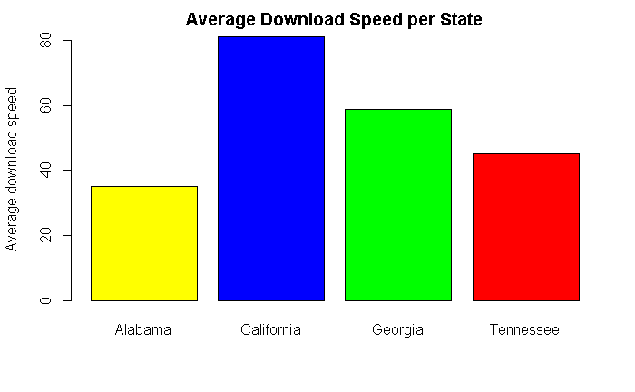
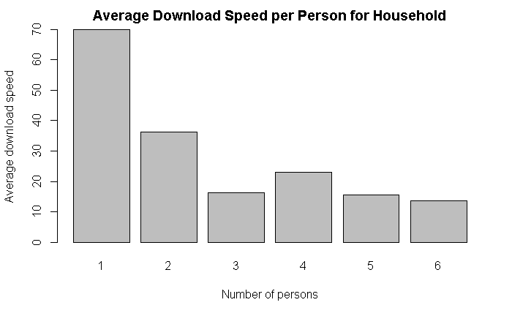
Download speed per state
Download speed per person per household

Slide 13
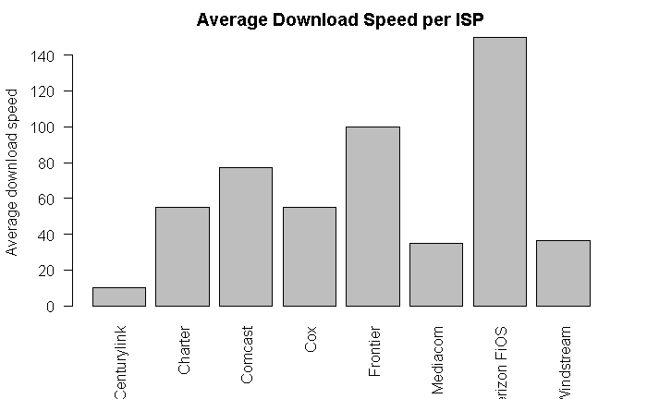
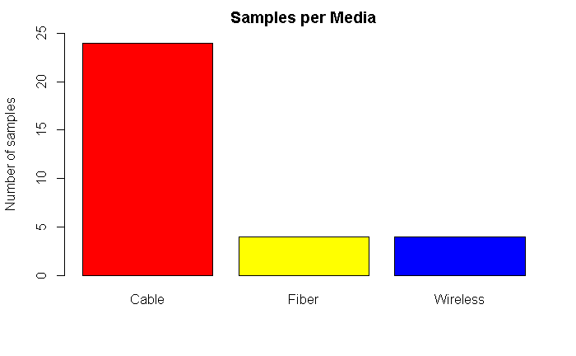
Download speed per isp
Samples per media

Slide 14
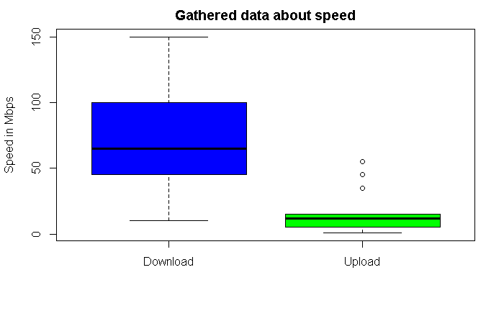
Boxplot of bandwidth responses

Slide 15
Jointly Distributed Analysis
Same uploaded survey responses used for jointly distributed analysis
Created a SLR model to predict bandwidth by # of people per household using built-in R functions
Assessed validity via LINE assumptions using built-in R functions

Slide 16
Results and Discussion

Slide 17
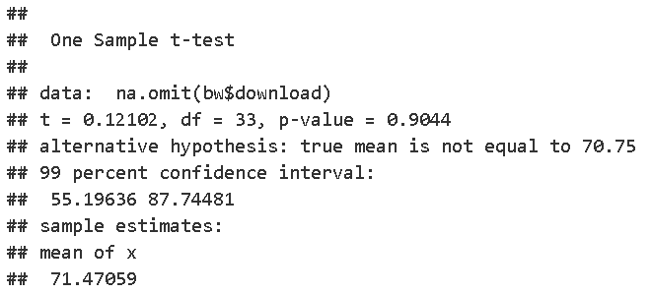
Univariate Analysis- Download Speed
Is the average download speed per household in the United States 70.75mbps?
There is insignificant evidence to say otherwise
P-value = 0.9044

Slide 18
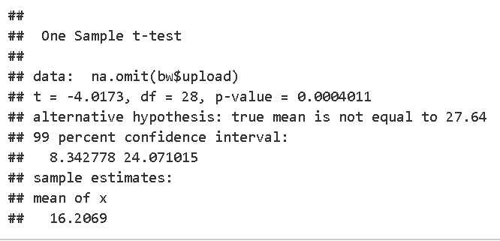
Univariate Analysis- Upload Speed
Is the average upload speed per household in the United States 27.64mbps?
There is significant evidence to say the mean upload speed is not 27.64
P-value = 0.0004

Slide 19
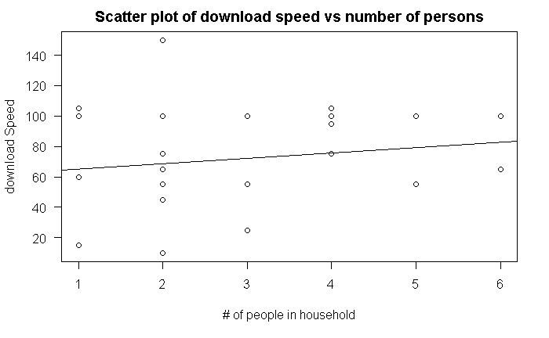

Jointly Distributed Analysis
y = 61.418 + 3.524(# in household)
$R^{2}=$0.019
Not a strong relationship
Do consumers know how much bandwidth they require
Availability options

Slide 20
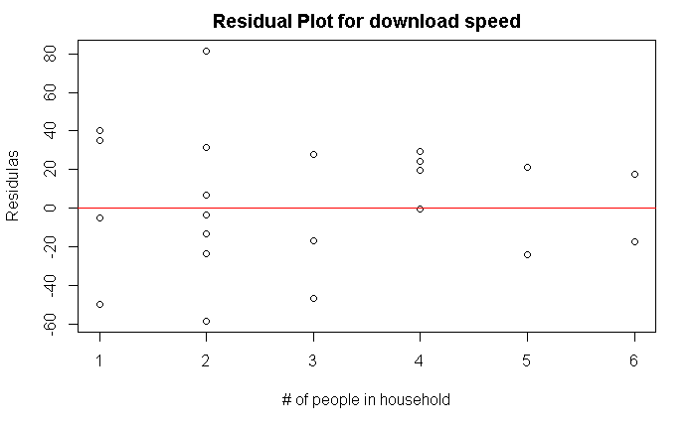
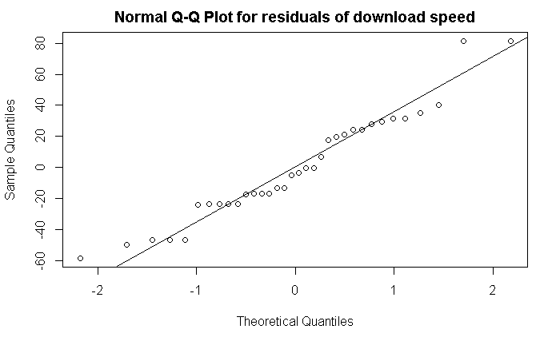
Jointly Distributed Analysis
Homoscedasticity
Normality of Residuals

Slide 21
Conclusion

Slide 22
Limitations of Research
Time constraint
Small sample size
Convenience sampling
Non-random
Geographically similar
Accuracy of responses
Limited knowledge of media
Real vs. advertised download speeds

Slide 23
Internal and external validity
Internal Validity
Criterion Validity
Real vs. advertised download speeds
External Validity
Population Validity
Small non-random sample
Friends, family, and colleagues of data interested individuals
Ecological Validity
Results from cities vary from rural areas due to availability
Temporal Validity
Held constant for mean hypothesis test as both predicted vs tested were in the year 2017
As technology increases, the mean bandwidth and prediction model will not hold constant

Slide 24
Contribution and Further Work
Back Speedtest’s estimate about download speed, but find that upload speed estimate is possibly too high
Begin the conversation about whether people are paying for too much bandwidth
To improve this study:
Larger sample size including a larger geographic distribution
Experimenting vs. surveying
More time for a larger sample size
Expanding the survey/experiment outside of the United States

Slide 25
Questions?

